Slide 1


Slide 2
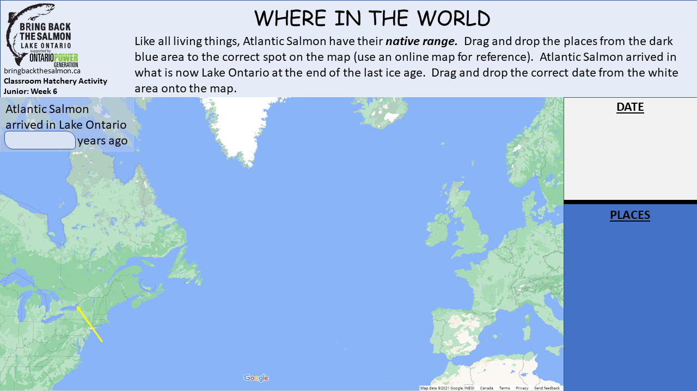
150
12 000
1500
1 000 000
U.S.A
Atlantic Ocean
Canada
EUROPE
Lake Ontario
AFRICA
France
Portugal
Iceland
Greenland
Ireland
Norway
NORTH AMERICA

Slide 3
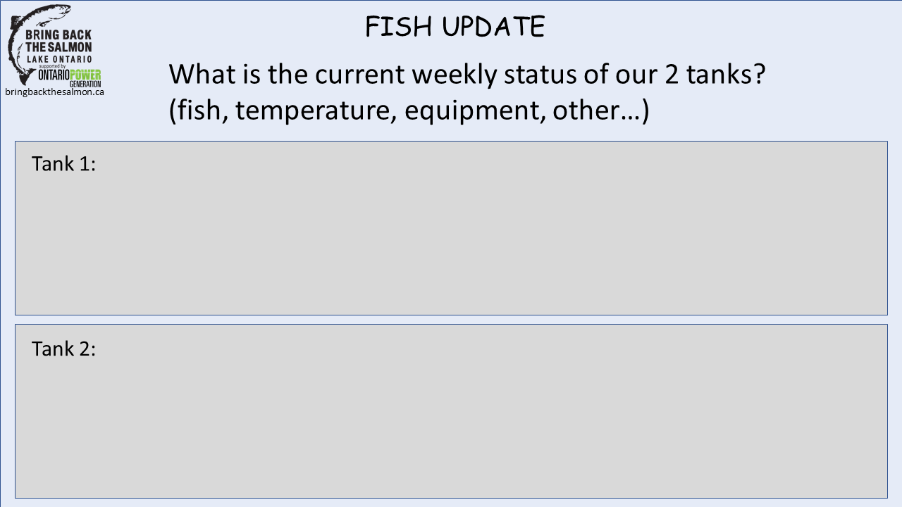

Slide 4
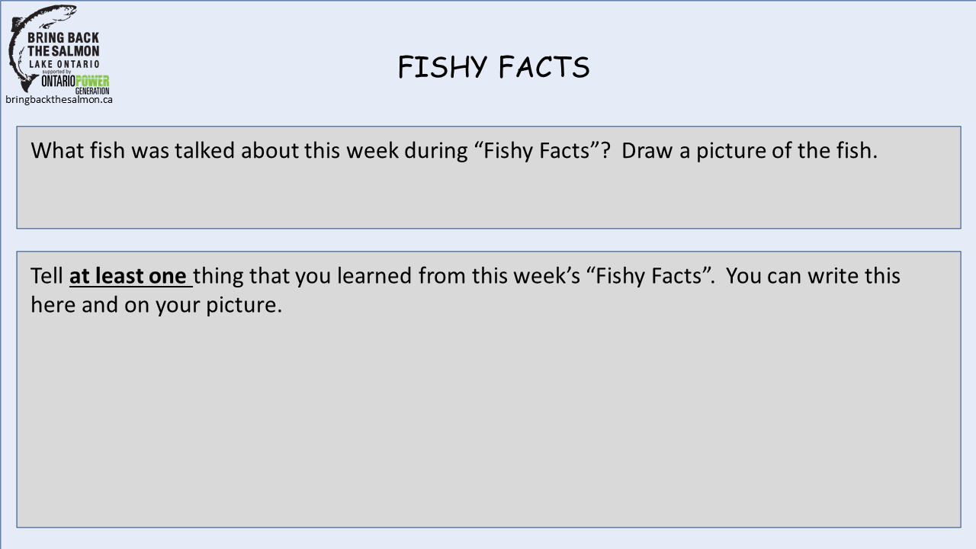

Slide 5
